Slide 1

Raspberry Pi
Prepared By:
Shrawan
stw0049@softwarica.edu.np

Slide 2


Raspberry Pi???

Slide 3
Raspberry Pi
Raspberry Pi is the name of a series of single-board computers made by the Raspberry Pi Foundation, a UK charity that aims to educate people in computing and create easier access to computing education.
Operates in the open source ecosystem.
It runs Linux (a variety of distributions), and its main supported operating system, Raspbian, is open source and runs a suite of open source software.
There have been three generations of Raspberry Pis: Pi 1, Pi 2, and Pi 3, and there has generally been a Model A and a Model B of most generations.

Slide 4
Introduction
In this project you will connect up a Raspberry Pi computer and find out what it can do.
The Raspberry Pi is a small computer that can do lots of things. You plug it into a monitor and attach a keyboard and mouse.

Slide 5
What you will need
HARDWARE:
A Raspberry Pi computer with an SD card or micro SD card
A monitor with a cable (and, if needed, an HDMI adaptor)
A USB keyboard and mouse
A power supply
Headphones or speakers (optional)
An Ethernet cable (optional)
SOFTWARE:
Raspbian, installed using the Raspberry Pi Imager.

Slide 6
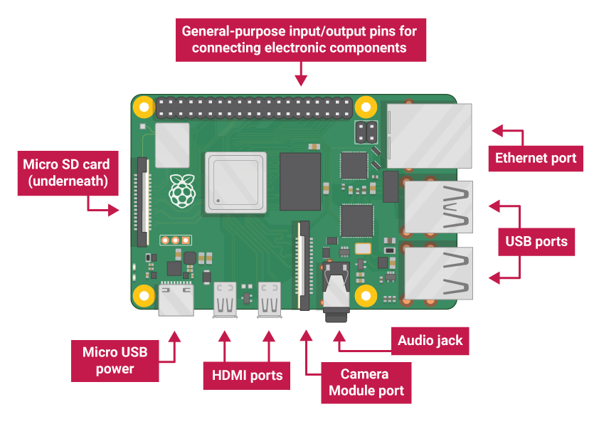
First look at Raspberry Pi

Slide 7
Set up
When you start your Raspberry Pi for the first time, the Welcome to Raspberry Pi application will pop up and guide you through the initial setup.

Slide 8
Set up
Click Next to start the setup.
Set your Country, Language, and Time zone, then click Next again.
Enter a new password for your Raspberry Pi and click Next.
Click Done or Reboot to finish the setup.
Note: you will only need to reboot if that’s necessary to complete an update.

Slide 9
Set up

Slide 10
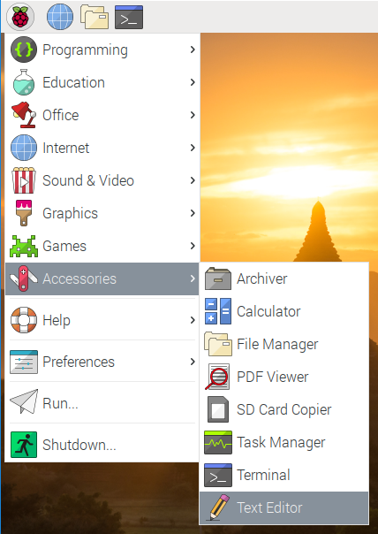
A tour of Raspberry Pi

Slide 11
Terminal

Slide 12
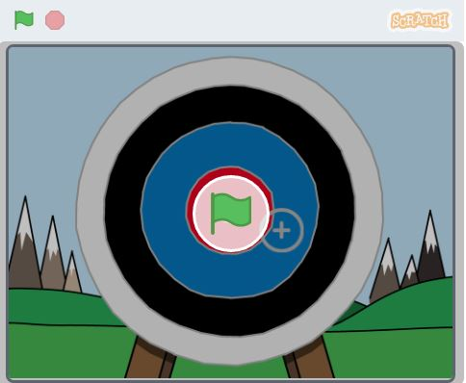
Scratch: Archery
Click on the green flag to start. Use the space bar to shoot an arrow

Slide 13
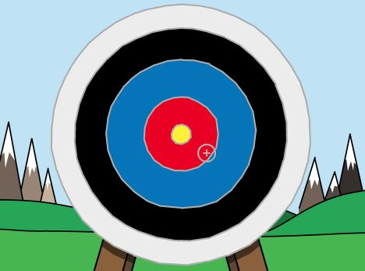
Aiming Arrows

Slide 14
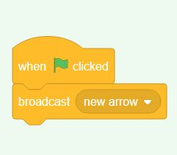
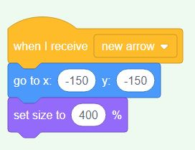
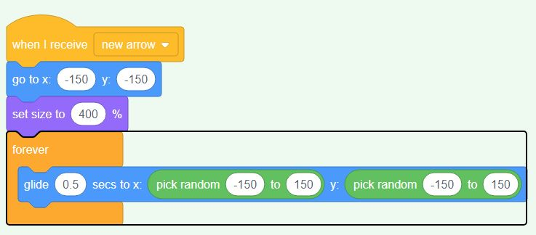
When your game starts, broadcast a message to shoot a new arrow

Slide 15
Thank You

